Slide 1
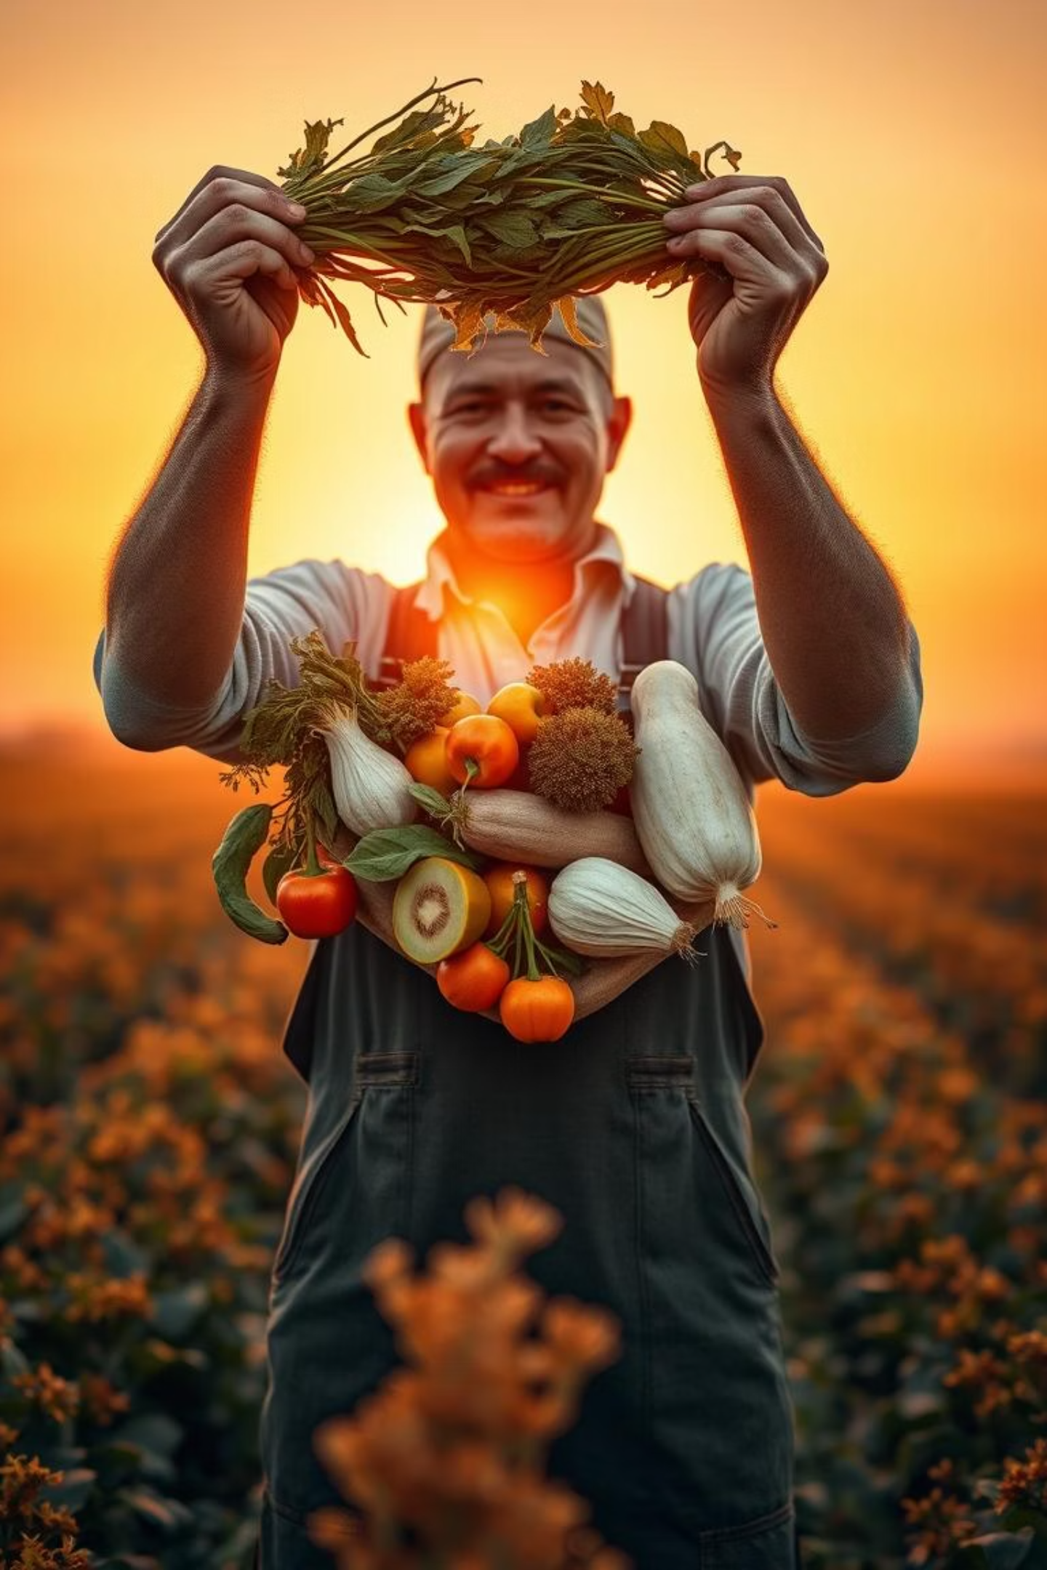
Empowering Farmers Through Value-Added Agricultural Products: Fueling Rural Entrepreneurship
Team Details:
ASIREDDY POOJITHA- 2400030486
KONAGANDLA NAGA VENKATA RITHIKA- 2400031872
ATLA LAKSHMI PRASANNA KUMARI -2400032275

Slide 2

Problem Statment
Farmers often struggle to sell raw produce at good prices.
Lack of guidance for creating value-added products.
Limited access to markets and buyers.
Need for a platform to promote rural entrepreneurship and increase income.

Slide 3
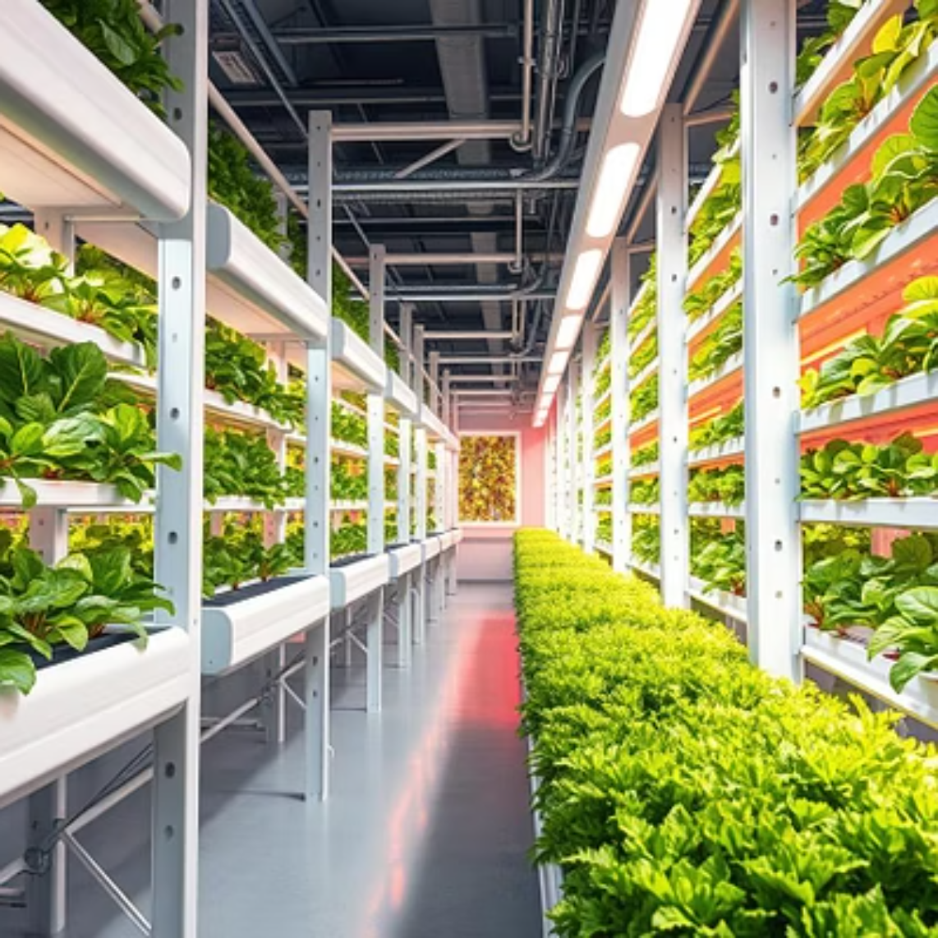
Importance Of This Website
Empowers farmers to increase income and self-reliance.
Encourages rural entrepreneurship and skill development.
Provides easy access to knowledge and market opportunities.
Reduces exploitation by middlemen and enhances product value.

Slide 4

Target Users
Small and medium farmers.
Rural entrepreneurs interested in producing and selling value-added products.
Buyers and shops looking for local, high-quality agricultural products.
NGOs and government organizations supporting rural development.
Students and researchers interested in agricultural entrepreneurship.

Slide 5

Advantages of this Platform
Empowers farmers to increase income and self-reliance.
Encourages rural entrepreneurship and skill development.
Provides easy access to knowledge and market opportunities.
Reduces exploitation by middlemen and enhances product value.
Promotes sustainable agricultural practices.
Connects farmers to modern technology and innovative tools.

Slide 6
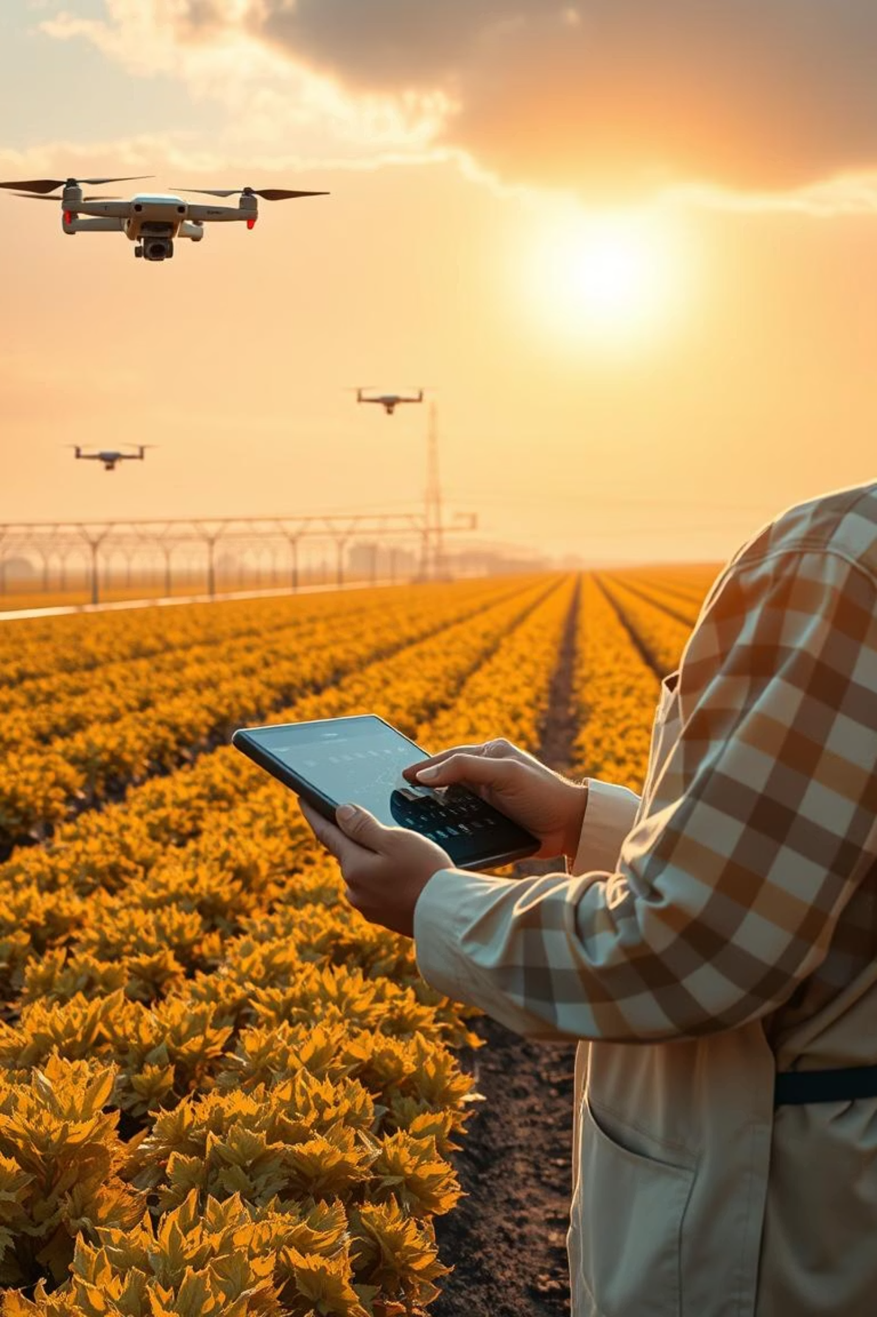
Key Features
Training & Tutorials: How to produce value-added products.
Market Access: Connect farmers with buyers and shops.
Resource Hub: Tips on packaging, branding, and pricing.
Community Forum: Share experiences and advice.
Progress Tracking: Track sales, production, and growth.

Slide 7

Technolgy Archeitecturre :
ReactJS / React Native: Interactive and responsive UI.
HTML, CSS, JavaScript: Core web technologies.
TailwindCSS / Material UI: Clean, modern design.
Integration: Connect with backend APIs, payment gateways, and chat systems.

Slide 8

Challenges &Solutions
Farmers don’t know how to make value-added products → Provide easy tutorials.
Farmers struggle to find buyers → Create a marketplace for direct sales.
Limited tools and resources → Give tips for packaging, branding, and marketing.
Low awareness of modern farming techniques → Offer online training and guidance.
Difficulty in selling products at good prices → Help with pricing and connecting to buyers.

Slide 9
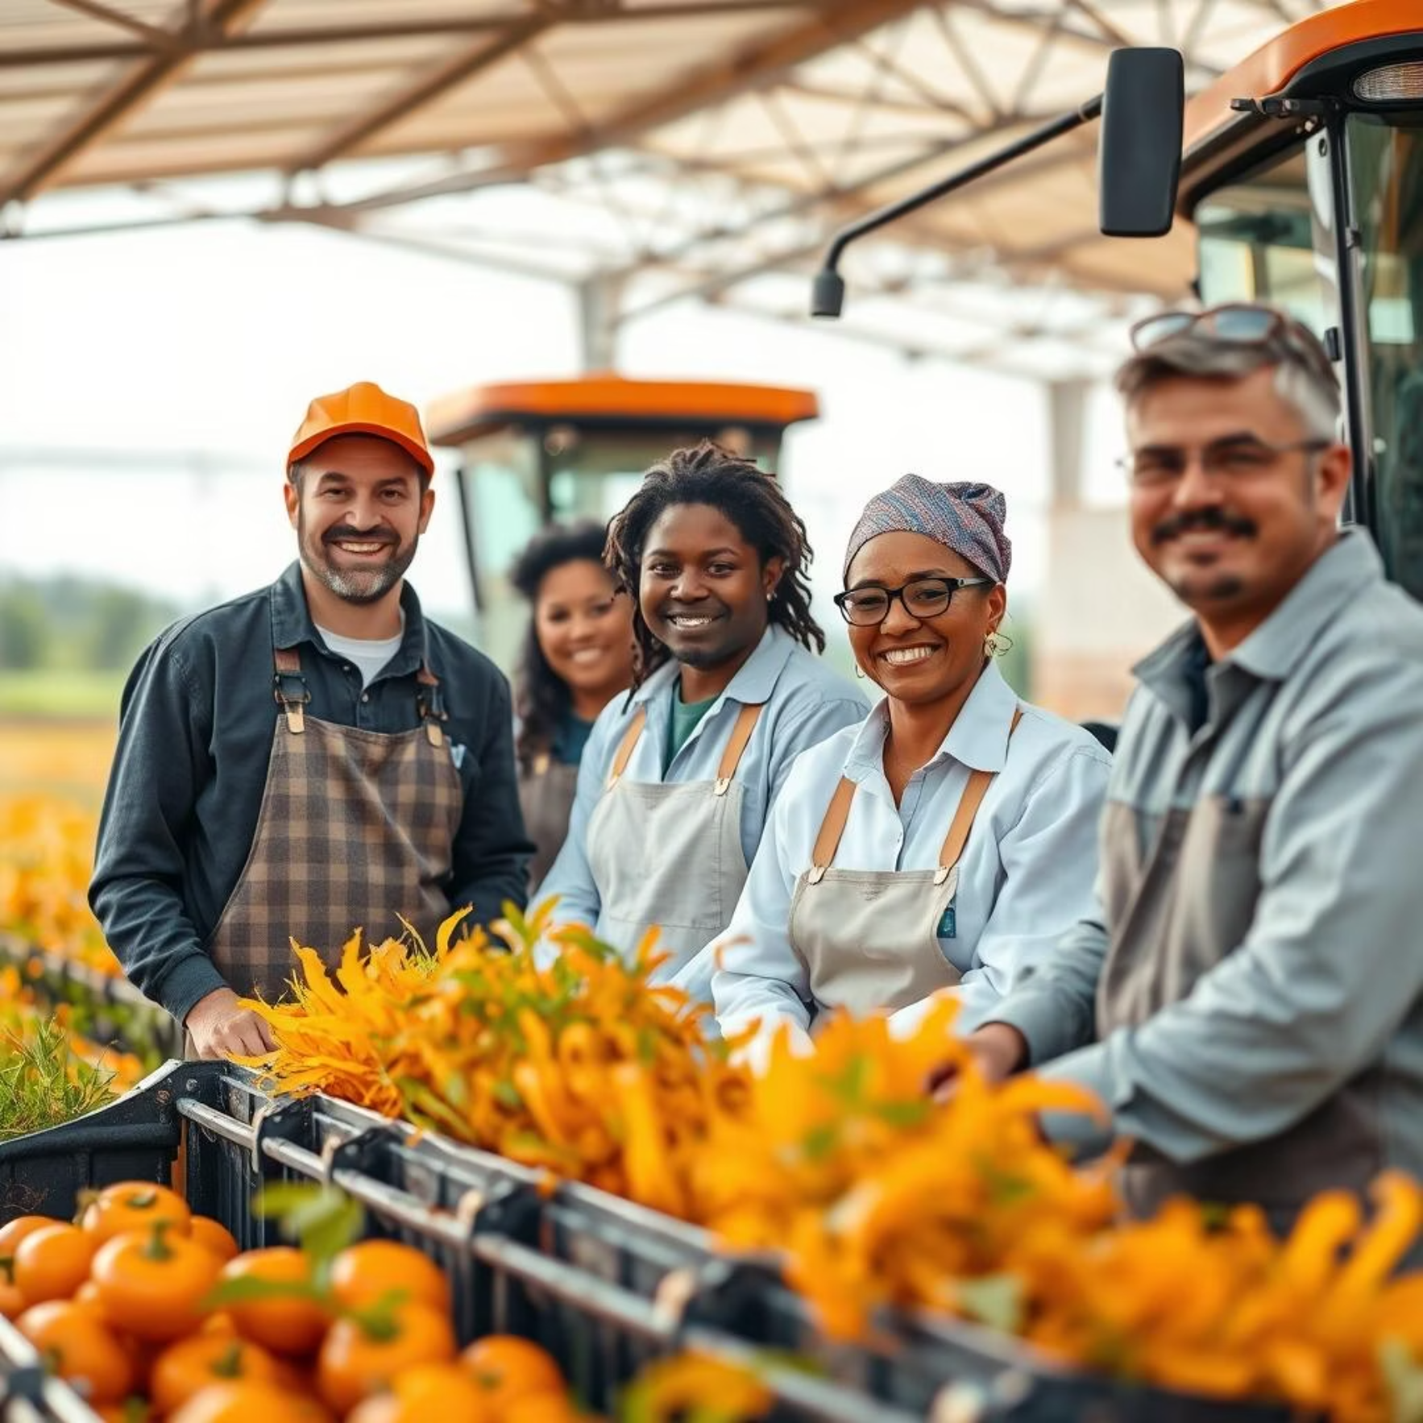
Future Scope
Expand the platform to more rural areas across the country.
Use AI to suggest best ways to process crops and set prices.
Work with NGOs and government programs to support farmers.
Make a mobile app for farmers to use easily on phones.
Add features for tracking sales, production, and growth over time.

Slide 10
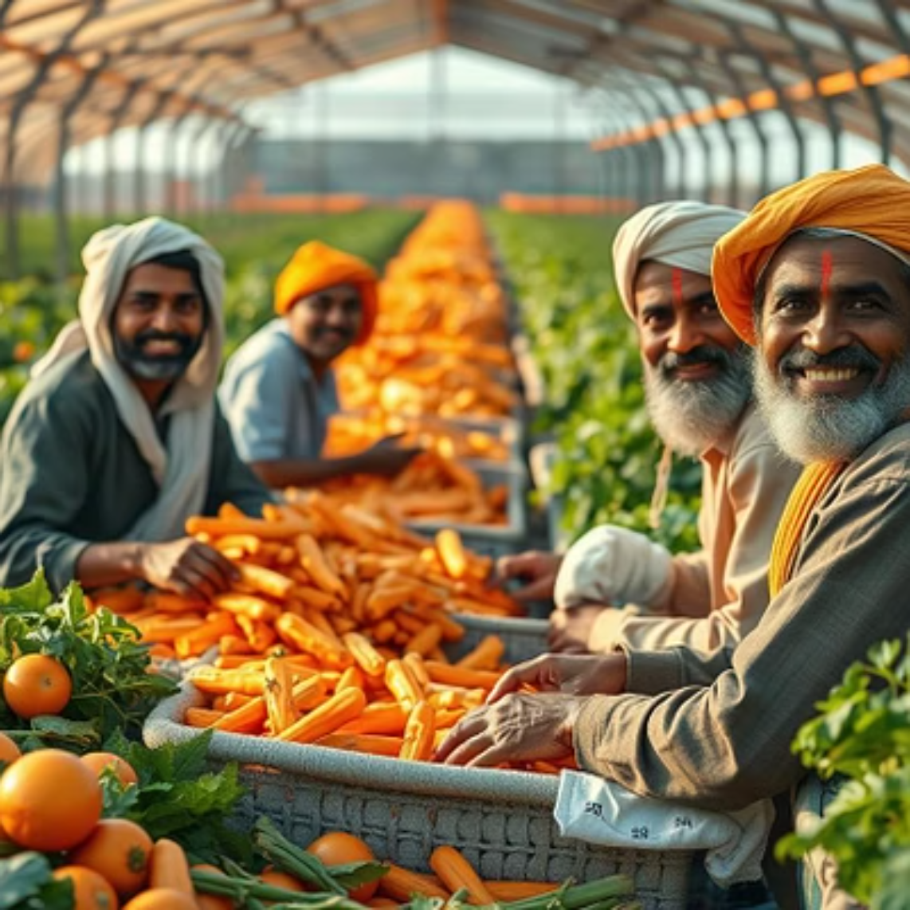
THANK YOU

